Slide 1

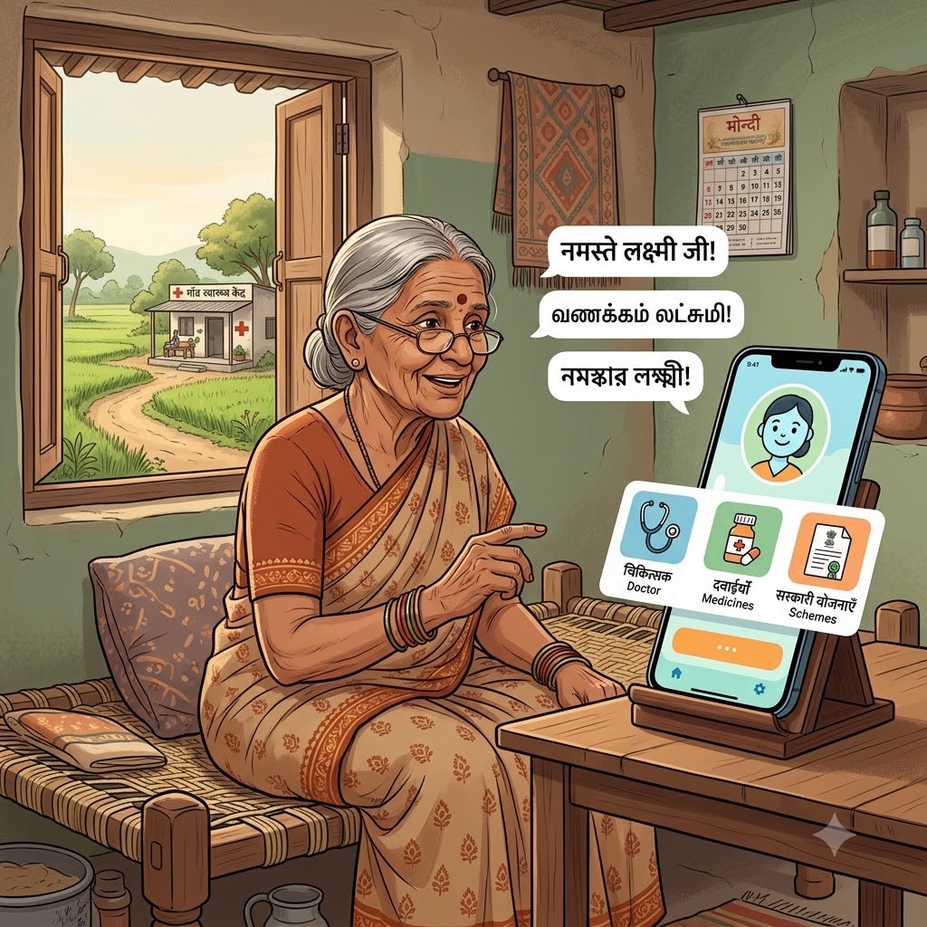

DECODE SIH 2026
OSCode
by communityX
🏆Bharat Shakti
PROBLEM STATEMENT 1
AI Rural Health Assistant — Multilingual
Healthcare Access & Government Scheme Guidance
THEME : HEALTH TECH
PRESENTED BY:
CODE ALCHEMISTS
“ONE VOICE COMMAND, INSTANT HEALTHCARE GUIDANCE.”

Slide 2
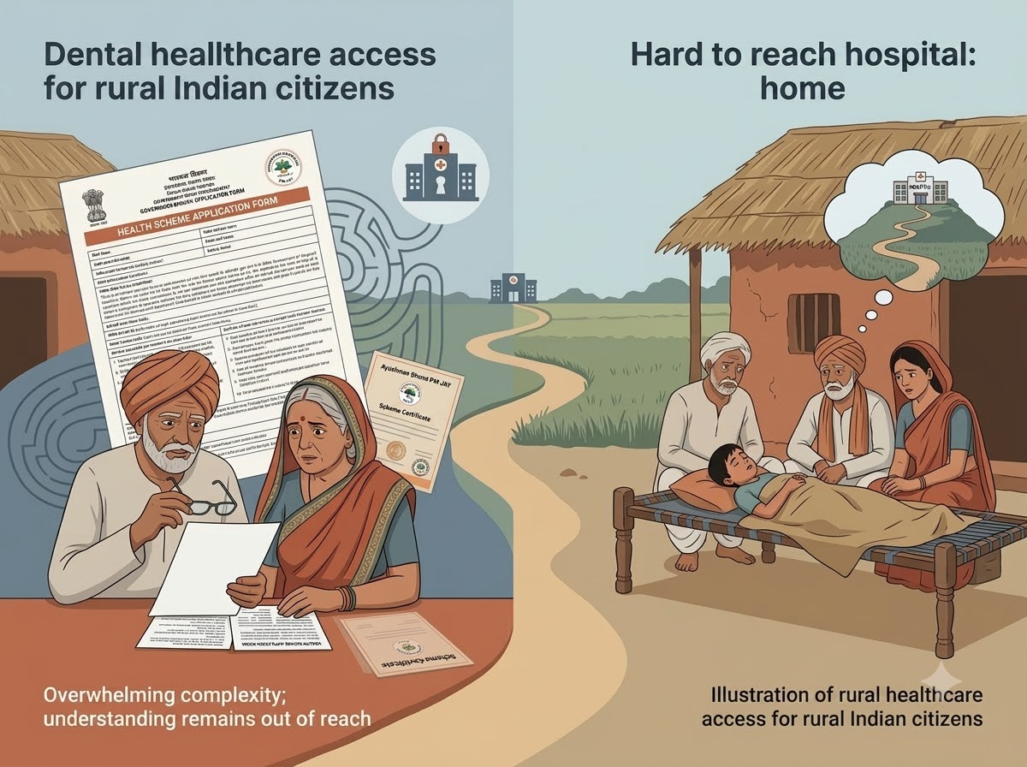
REAL WORLD PROBLEM
Language and Literacy Barriers: Rural citizens face severe barriers accessing healthcare because vital scheme details are only available in formal languages and complex forms they cannot easily read.
Lack of Program Awareness: Consequently, millions of vulnerable families remain completely unaware of their eligibility for crucial government programs like Ayushman Bharat.
Difficulty with Symptom Triage: During sudden illnesses, patients struggle with safe symptom triage, leaving them unsure whether to seek home care or emergency medical help.
Inability to Locate Facilities: Patients face significant challenges in easily locating the nearest healthcare facilities when they need them.
TEAM MEMBERS KAMALESHWARAN B (TEAM LEAD) VISHNUVARDHAN B KEVIN CRIS F JOHN EZRA P SRIHARINI D POOJA SRI AB
"FROM RURAL SYMPTOM TO RIGHT SOLUTION IN YOUR MOTHER TONGUE."

Slide 3
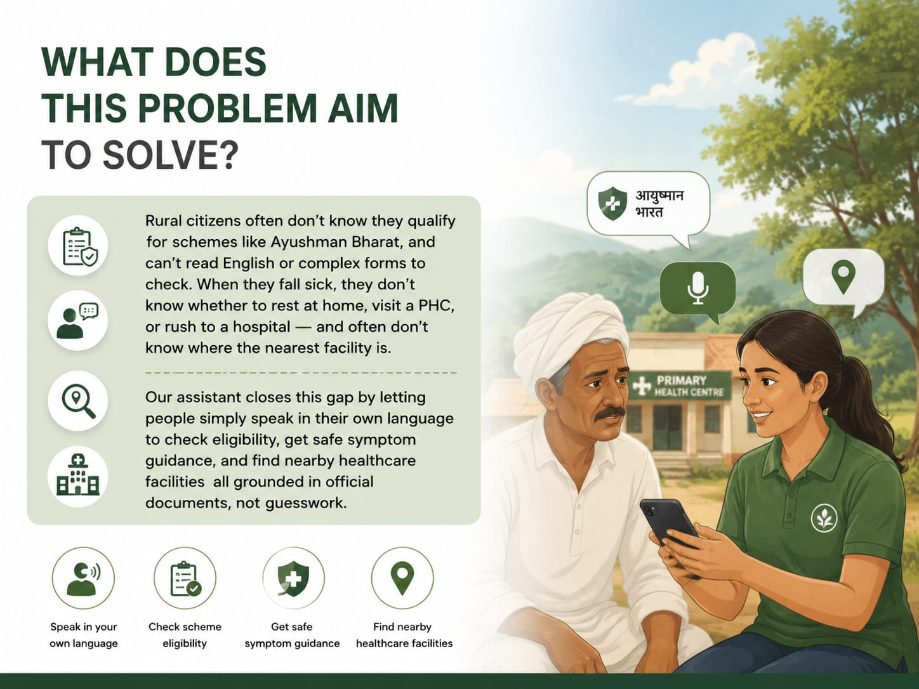
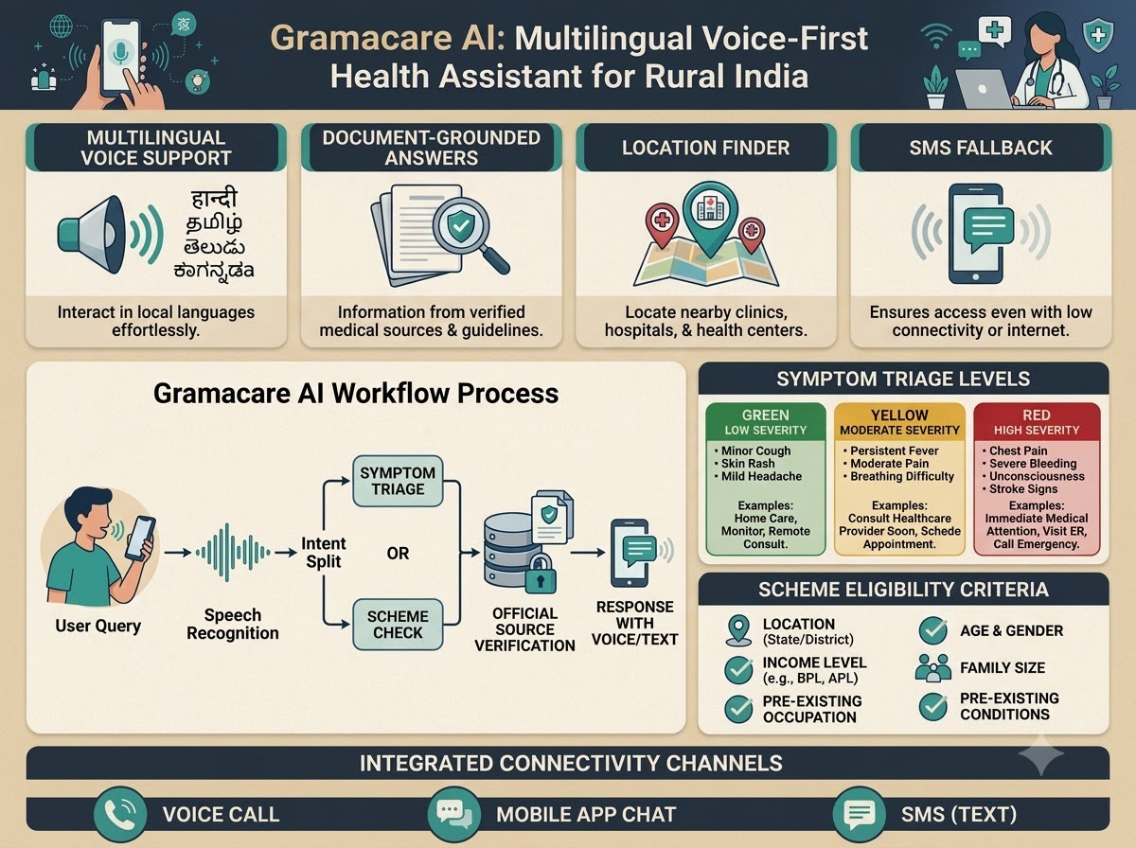
PROBLEM STATEMENT
OSCode
by communityX
What does this problem aim to solve?
Rural citizens often don’t know they qualify for schemes like Ayushman Bharat, and can’t read English or complex forms to check. When they fall sick, they don’t know whether to rest at home, visit a PHC, or rush to a hospital — and often don’t know where the nearest facility is. Our assistant closes this gap by letting people simply speak in their own language to check eligibility, get safe symptom guidance, and find nearby healthcare facilities all grounded in official documents, not guesswork.
Why did your team choose this?
This problem sits at the intersection of real impact and real feasibility. Millions of rural families are entitled to free healthcare and financial protection but never claim it, simply because of language and awareness barriers. It’s a problem software can genuinely fix — no new hospitals or infrastructure needed, just better access to information that already exists.
Who faces this issue?
Rural citizens — especially elderly and semi-literate users — who can’t read English/Hindi scheme documents or navigate government portals, and overloaded ASHA/ANM frontline workers who can’t reach every household in time.

Slide 4
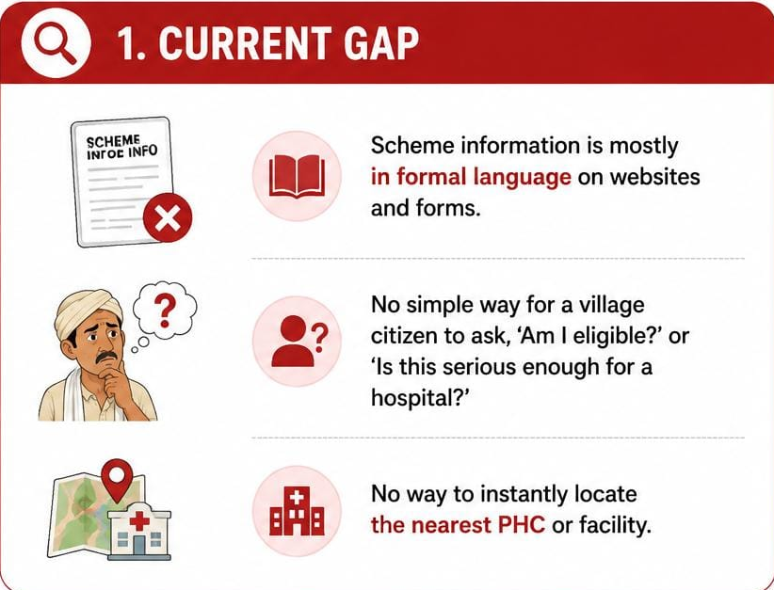
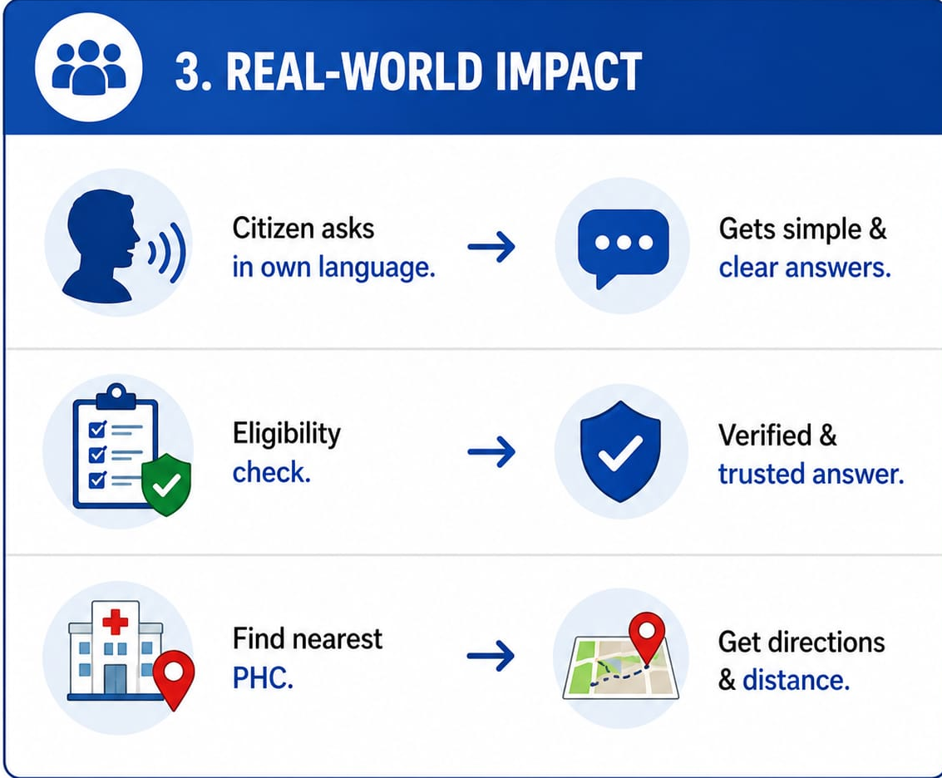
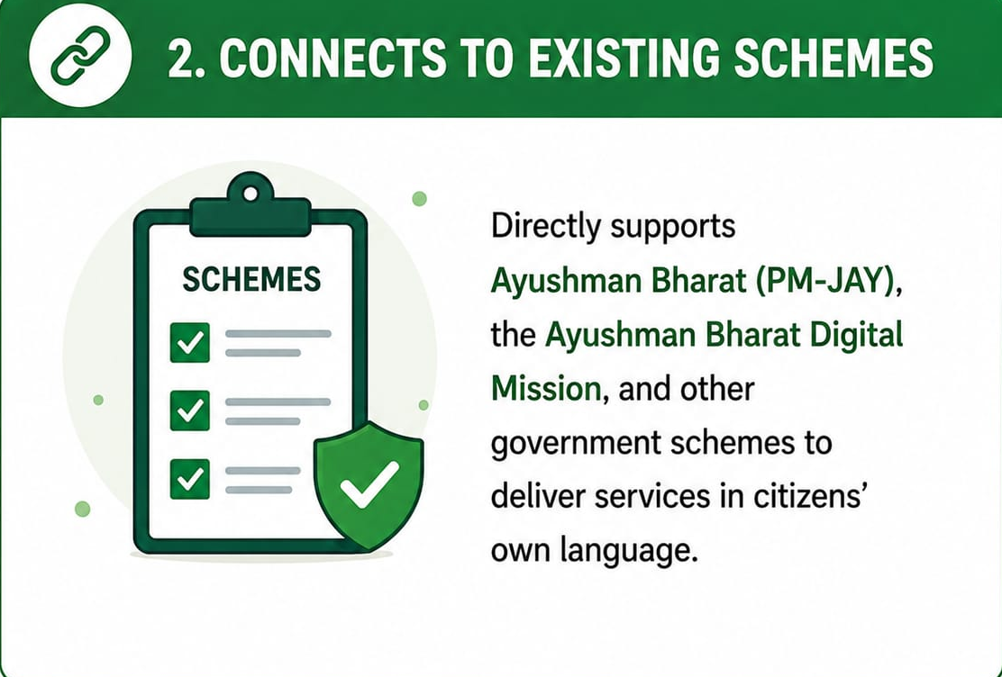
REAL-WORLD PROBLEM ALIGNMENT
How does your proposed solution fill that gap practically?
A voice-first assistant lets users speak in Tamil, Hindi, Telugu, and more. It checks real scheme documents to answer eligibility questions, uses a safe rule-based triage engine to guide home-care vs PHC vs emergency decisions, and locates the nearest facility — every answer traceable to its source.
OSCode
by communityX
What’s the current gap in the system?
Scheme information exists only in formal language on websites and forms. There’s no simple way for a village citizen to ask, in their own dialect, ‘am I eligible?’ or ‘is this serious enough for a hospital?’ — and no way to instantly locate the nearest PHC.
Connects to existing schemes
Directly supports Ayushman Bharat (PM-JAY), the Ayushman Bharat Digital Mission, and the National Health Mission — and aligns with the Digital India vision of bringing government services to citizens in their own language.

Slide 5
OSCode
PROPOSED SOLUTION
by communityX
What are you building?
Gramacare AI is a multilingual, voice-first health assistant built for rural India. A user speaks their question in Tamil, Hindi, Telugu, or another local language — the assistant transcribes it, understands the intent, and replies in the same language as text and spoken audio. It answers two kinds of questions: eligibility for schemes like Ayushman Bharat, and how serious a symptom is — guiding the user toward home care, a nearby PHC, or emergency help. Every answer is grounded in official scheme documents and WHO/ICMR protocols, with the source shown alongside. It also locates the nearest facility, and falls back to SMS/USSD in low-connectivity areas so no one is left out.
What are the 3-4 key features?
1) Voice-first multilingual query & response in the user’s own dialect. 2) Source-grounded scheme eligibility & safe rule-based symptom triage. 3) Nearest health facility locator. 4) SMS/USSD fallback for low-connectivity areas.
What makes it different or innovative?
Every answer is grounded and cited — it never guesses on medical or scheme information. It’s designed to support, not replace, ASHA/ANM workers, and it works across voice, app, and SMS/USSD, so it genuinely reaches low-end phones and unstable rural networks instead of just claiming to.

Slide 6
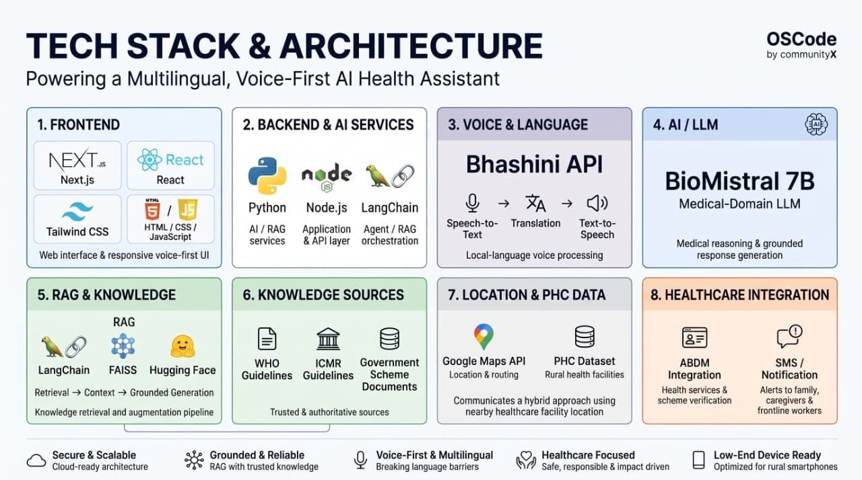

Slide 7
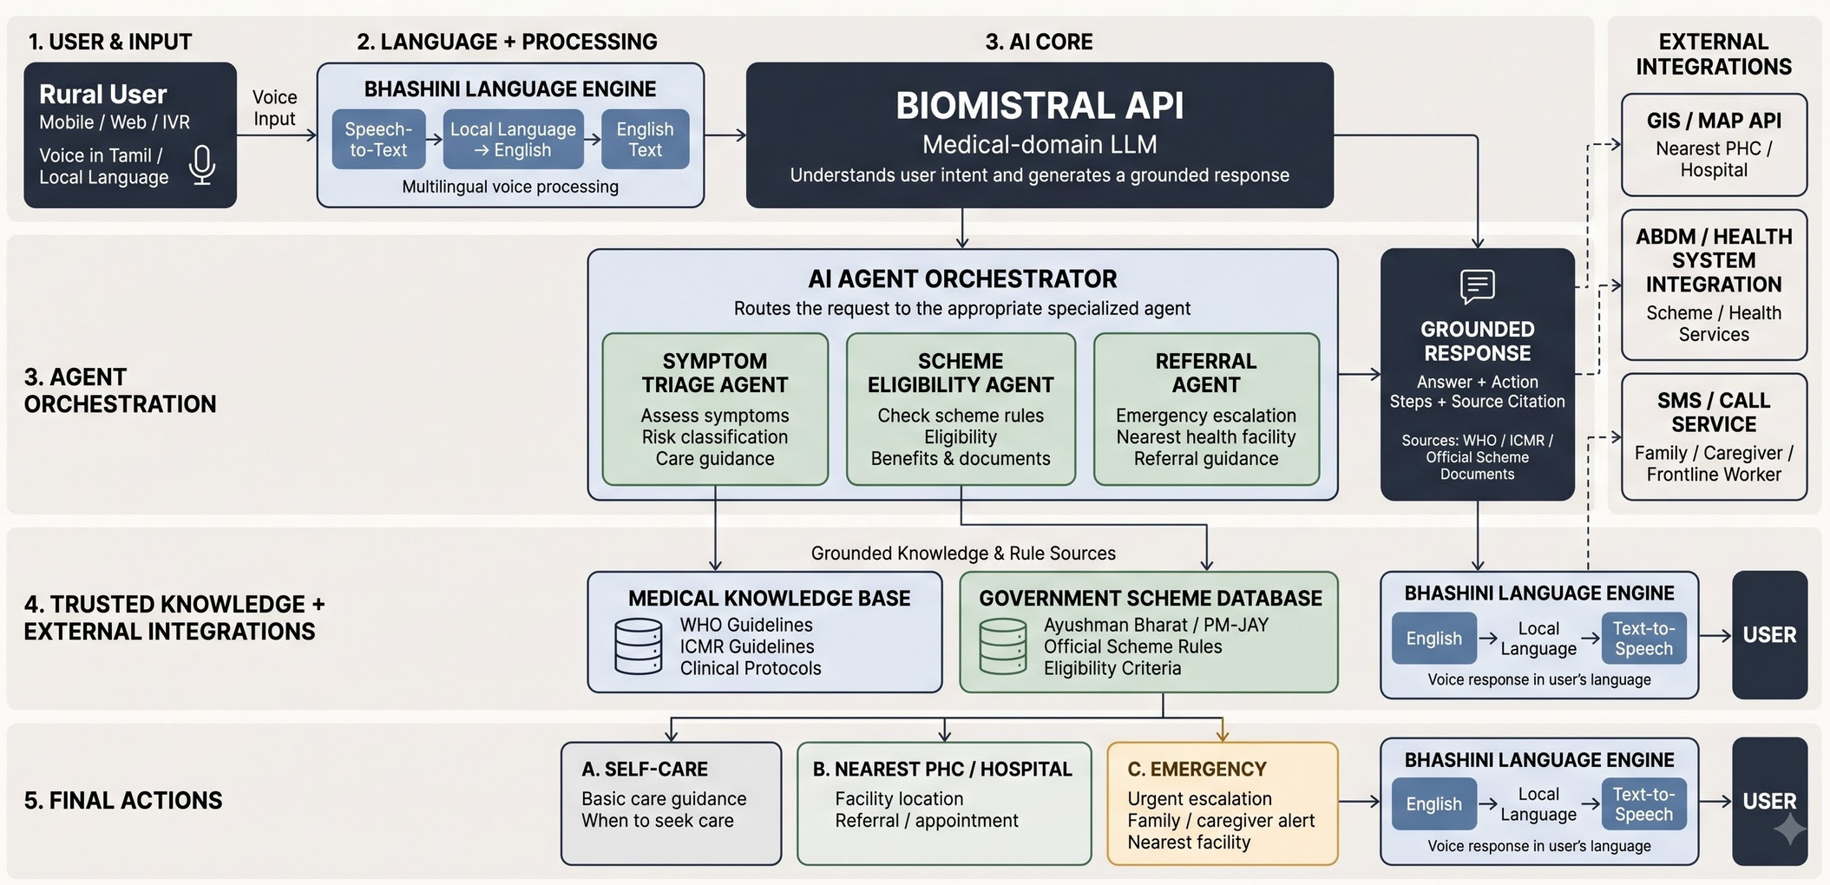
OSCode
ARCHITECTURE DIAGRAM
by communityX
End-to-end flow: Voice input → Bhashini language layer → RAG + Triage reasoning → grounded LLM answer → voice/SMS response back to the citizen.

Slide 8
OSCode
RESEARCH AND RESOURCES
by communityX
National Health Authority (NHA), Government of India Ayushman Bharat Digital Mission (ABDM) ⁠￼ https://abdm.gov.in/abdm
National Health Authority (NHA), Government of India Health Facility Registry (HFR) https://abdm.gov.in/health-facilities
National Health Authority (NHA), Government of India ABDM — Multilingual Support & Citizen Services https://abdm.gov.in/call-center
⁠National Health Mission (NHM), Ministry of Health & Family Welfare, Government of India Accredited Social Health Activist (ASHA) Programme https://nhm.gov.in/nammamihaan/index1.php?lang=1&level=1&lid=226&sublinkid=150
⁠5. World Health Organization (WHO) Interagency Integrated Triage Tool
https://www.who.int/tools/triage ⁠￼
6. National Health Authority (NHA), Government of India ABDM — Health Facility Registry
& Digital Health Ecosystem https://abdm.gov.in/ebook
⁠￼
"SPEAK IN YOUR DIALECT, SECURE YOUR HEALTH."

